Slide 1




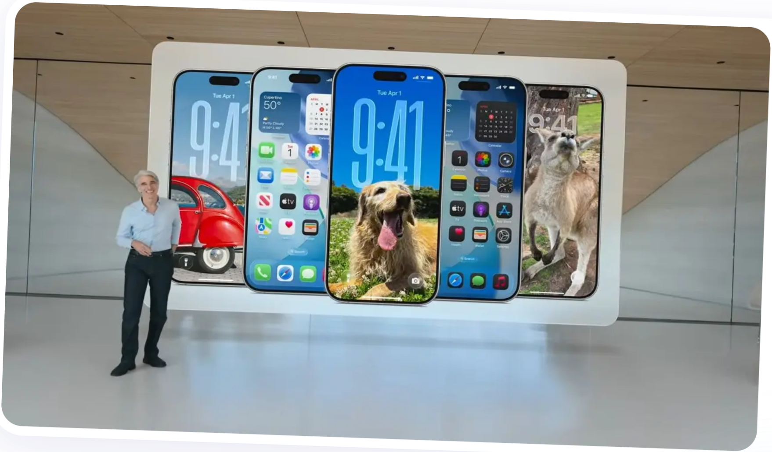




iOS 26
The Next Evolution
Liquid Glass Design Language
Apple Intelligence Integration
Enhanced Communication Features
June 2025

Slide 2



















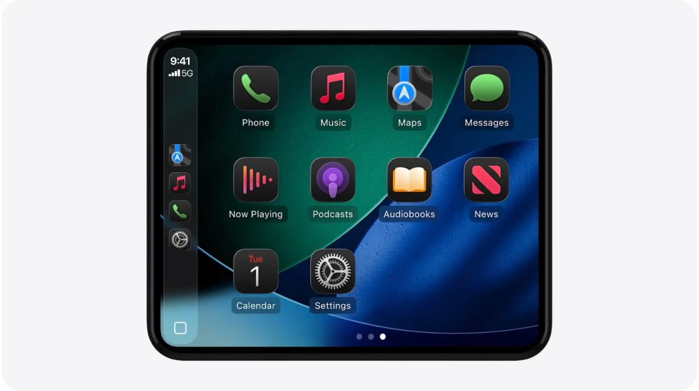



CarPlay & Apple Music Updates
CarPlay
Apple Music
Used over 600 million times per day
Lyrics Enhancement
AutoMix
Refreshed with Liquid Glass design language
DJ-like experience with seamless transitions between songs
Compact call view preserves navigation visibility
Translation and pronunciation features for lyrics in different languages
Enhanced Messages with Tapbacks & pinned conversations
New widget support and Live Activities integration
Karaoke Mode
Library Organization
Use iPhone as microphone for karaoke with Apple TV
Pin favorites and create playlist folders for better organization
Dynamic Tab Bar
Floating tab bar that shrinks while browsing to maximize content visibility
10 / 15

Slide 3













Maps & Wallet Innovations
Apple Maps
Apple Wallet
Visited Places
Enhanced Payment Options
Automatically remembers places you've been with end-to-end encryption for privacy. View restaurant and shop history directly in Maps.
Choose installments or rewards when making in-store purchases with Apple Pay.
Digital Passport
Preferred Routes
U.S. users can add digital passport to Wallet for use at select TSA checkpoints, in apps, and in person.
On-device intelligence learns your daily commutes, presents preferred routes, and notifies of delays with alternative suggestions.
Refreshed Boarding Passes
Live Activities for flight updates, airport maps, Find My for tracking items, and shareable flight status.
Airport Navigation
Boarding passes in Wallet now provide direct links to Maps for seamless airport navigation.
Order Tracking
Apple Intelligence scans emails to identify and consolidate order tracking details, even for non-Apple Pay purchases.
11 / 15

Slide 4















Safari & Gaming Experience
Redesigned Safari
New Apple Games App
Enhanced Browsing Experience
All-in-One Gaming Hub
Web pages flow from top edge to bottom for more visible content
Central destination for your entire game library
Updated navigation with rounded Liquid Glass buttons
Integrates titles from both App Store and Apple Arcade
Optional floating tab bar to restore bottom settings
Helps rediscover beloved games and find new favorites
Privacy & Design Updates
Social & Cross-Platform Features
Advanced fingerprinting protection extended to all browsing by default
Connect with friends for multiplayer experiences
Game events, recommendations, leaderboards, and "Challenges" mode
Full Liquid Glass design integration throughout the interface
New "Compact" floating tab style joins "Tab Bar" and "Single Tab" options
Cross-platform functionality with macOS for stats and inviting friends
12 / 15

Slide 5

















Additional App Improvements
Enhanced functionality across core iOS applications
Notes
Reminders
Files
Clock
Record and transcribe calls directly into notes
Add Reminders control to Control Center
Folder customization with colors and icons
Customizable alarm snooze (1-15 minutes)
Markdown now available as export option
Quick creation of reminders from anywhere
Set default apps for specific file types
Larger alarm stop/snooze buttons
Use audio files directly as ringtones
Calculator
Passwords
Journal
Preview App
Math Notes support for equations in 3 variables
Password history with change dates
Create multiple distinct journals
Mac Preview now on iPhone and iPad
3D graph visualization capabilities
Secure export to other password managers
Organize entries across different journals
PDF viewing, creation and annotation
Image editing tools (crop, flip, rotate)
13 / 15

Slide 6

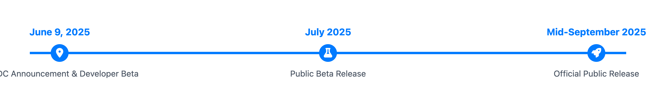










Release Timeline
Announcement
Public Beta
Public Release
June 9, 2025
July 2025
Mid-September 2025
Officially unveiled at Apple's Worldwide Developers Conference (WWDC)
Available to members of Apple's Beta Software Program
Final stable version available to all users
Free software update for compatible devices
Developer beta immediately available
Opportunity for early testing and feedback
iOS 26 marks the beginning of Apple's new year-based naming convention, with "26" representing the 2025-2026 release season.
14 / 15

Slide 7













































Device Compatibility
iOS 26 requires A13 Bionic chip or newer, with Apple Intelligence features limited to devices with A17 Pro chip or newer.
iPhone Model
Chip
iOS 26
Apple Intelligence
iPhone 16e
A17 Pro or newer
A17 Pro or newer
iPhone 16 & 16 Plus
A17 Pro or newer
A17 Pro or newer
iPhone 16 Pro & 16 Pro Max
A17 Pro or newer
A17 Pro or newer
iPhone 15 Pro & 15 Pro Max
A17 Pro
A17 Pro
iPhone 15 & 15 Plus
A16 Bionic
A16 Bionic
iPhone 14 & 14 Plus
A15 Bionic
A15 Bionic
iPhone 14 Pro & 14 Pro Max
A16 Bionic
A16 Bionic
iPhone 13 & 13 mini
A15 Bionic
A15 Bionic
iPhone 13 Pro & 13 Pro Max
A15 Bionic
A15 Bionic
iPhone 12 & 12 mini
A14 Bionic
A14 Bionic
iPhone 12 Pro & 12 Pro Max
A14 Bionic
A14 Bionic
iPhone 11, 11 Pro, & 11 Pro Max
A13 Bionic
A13 Bionic
iPhone SE (2nd generation and later)
A13 Bionic or newer
A13 Bionic or newer
iPhone XS, XS Max, and XR (A12 Bionic) are not supported
iOS 26 will be available as a free software update
15 / 15

Slide 8











Introduction to iOS 26
Unveiled at WWDC 2025
Year-Based Naming
Announced on June 9, 2025 during Apple's annual Worldwide Developers Conference.
The "26" signifies the 2025-2026 release season, introducing a new naming convention aligned with year-based strategy.
New Design Language
"Liquid Glass" design makes system experiences more expressive and delightful while retaining iOS familiarity.
Apple Intelligence
Integrates powerful AI capabilities across the system, designed to enhance user productivity with privacy-focused features.
"iOS 26 shines with the gorgeous new design and meaningful improvements to the features users rely on every day, making iPhone even more helpful."
— Craig Federighi, Apple's Senior VP of Software Engineering
2 / 15

Slide 9







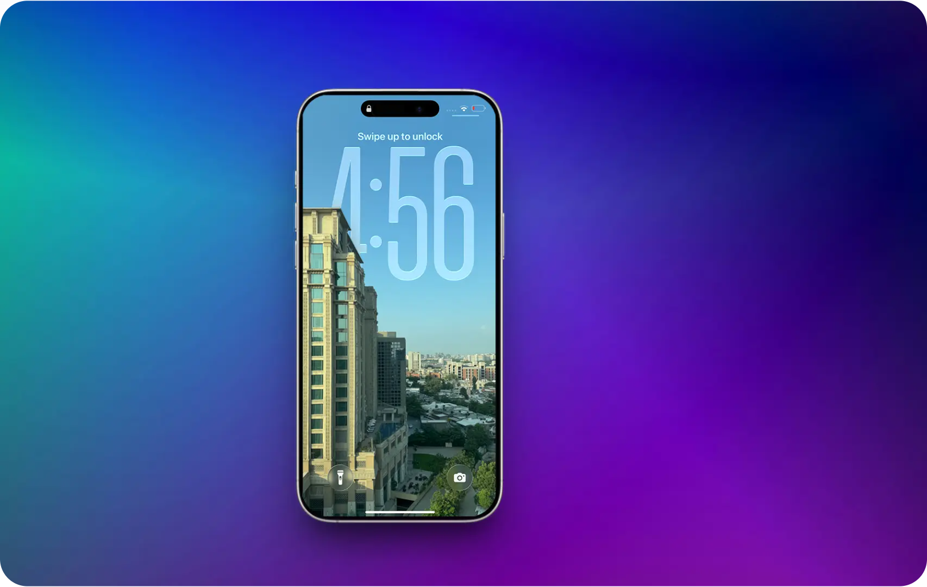










Liquid Glass Design
Depth & Vitality
Inspired by visionOS
Translucent, glass-like elements that reflect and refract surroundings, replacing the flatter design of previous iOS versions.
System-Wide Application
Applied to controls, navigation, app icons, widgets, Lock Screen, Home Screen, notifications, and Control Center.
Refined Controls
Controls and toolbars feature more rounded corners on a distinct functional layer designed to sit above apps.
Developer Integration
Lock Screen showing spatial scenes and depth effects with Liquid Glass design
Updated APIs allow developers to incorporate Liquid Glass materials and components into their apps for a cohesive look.
3 / 15

Slide 10

























Lock Screen & Home Screen Enhancements
Lock Screen
Home Screen
10:09
Dynamic Time Adaptation
App Icon Customization
Time display intelligently adjusts to available space in wallpaper images
Updated light and dark appearances with color-tinting options
Tuesday, June 9
Spatial Scenes
Layered Liquid Glass
Wallpapers come alive with 3D effects that respond to iPhone movement
App icons and widgets feature multiple layers of Liquid Glass for enhanced depth
Bottom Widgets
Place widgets at the bottom of the Lock Screen for easier access
Clear Look
Stunning transparent icon style crafted from Liquid Glass material
4 / 15

Slide 11


























App Interface Redesigns
Streamlined layouts with floating elements and Liquid Glass controls
Camera
Photos
Simplified layout with prominent Photo/Video toggles
Expandable, scrollable command bar for additional shooting modes
Enhanced controls with rounded Liquid Glass design
Reintroduced separate tabs for Library and Collections views
Enhanced navigation with Liquid Glass elements
Improved content organization and accessibility
Safari
Music, News & Podcasts
Web pages flow from top edge to bottom of screen
Updated navigation with rounded Liquid Glass buttons
Optional floating tab bar to replace removed bottom settings
Redesigned tab bars floating above content
Dynamic resizing: shrinks when browsing, expands when scrolling
Content-first approach prioritizing media visibility
Common Design Elements
More rounded corners
Distinct functional layers
Translucent materials
Morphing controls
5 / 15

Slide 12








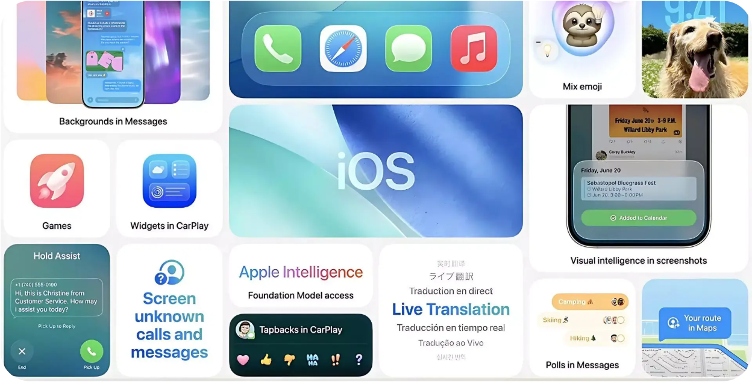










Apple Intelligence Integration
Powerful AI capabilities with privacy at the core
Privacy-First Approach
Intelligent Shortcuts
On-device processing for many features maintains user privacy and data security
New "intelligent actions" enable powerful workflows with Writing Tools and Image Playground
Order Tracking Summary
Foundation Models Framework
Automatically identifies and consolidates tracking details from emails, even for non-Apple Pay purchases
Gives developers access to on-device AI models for fast, private, offline-capable features
System-wide integration of intelligent features
Apple Intelligence enhances user productivity and interaction in a privacy-focused manner, running entirely on-device for many features.
Private
Powerful
Personal
Proactive
Integrated
6 / 15

Slide 13




















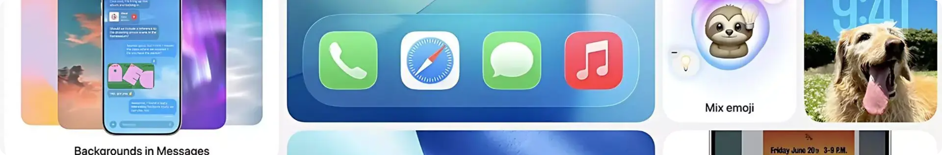
Live Translation & Visual Intelligence
Live Translation
Visual Intelligence
Communicate across languages with on-device translation for text and audio, preserving privacy through Apple-built models.
Extends to your iPhone screen, allowing you to search and take action on anything you're viewing across apps.
Messages
AI Analysis
Automatically translates texts in conversations, allowing seamless multilingual messaging.
Ask ChatGPT questions about on-screen content for immediate insights and information.
FaceTime
Visual Search
Displays translated live captions while preserving the speaker's original voice for natural conversation.
Find similar images or products via Google, Etsy, or other supported apps with a simple tap.
Phone
Smart Recognition
Translations are spoken aloud during calls, enabling real-time verbal communication across languages.
Identifies art, books, landmarks, sculptures, and event details with suggestions for calendar integration.
7 / 15

Slide 14








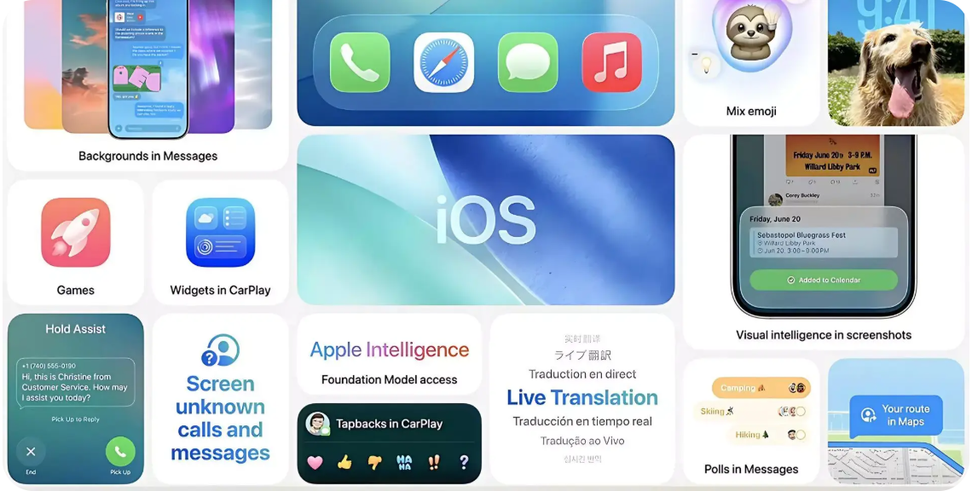
Creative Expression Tools
Unleash your creativity with Apple Intelligence
Genmoji
Image Playground
Enhanced Shortcuts
Mix your favorite emojis, Genmoji, and descriptions to create unique expressions.
Generate custom images with enhanced AI capabilities.
More powerful with "intelligent actions" enabled by Apple Intelligence.
Additional ChatGPT styles
Create custom backgrounds for Messages
Generate images from text descriptions
Apply artistic filters and effects
Dedicated actions for Writing Tools
Image Playground integration
Summarize text within workflows
Create images directly in automations
Combine multiple emojis
Add text descriptions
Generate personalized reactions
Share directly in Messages
8 / 15

Slide 15











Communication Enhancements
Smarter, safer, and more intuitive ways to stay connected
Phone App
Messages App
Unified Layout
Unknown Sender Screening
Combines Favorites, Recents, and Voicemails in one convenient place for streamlined access.
Messages from unknown senders appear in a dedicated folder and remain silenced until you accept them or mark them as known.
Call Screening
Custom Conversation Backgrounds
Gathers information from unknown callers before your phone rings, letting you decide whether to answer or ignore.
Personalize chats with custom backgrounds, including unique backgrounds generated with Image Playground.
Hold Assist
Typing Indicators
Smart Polls
See who's typing in group chats in real-time.
Create polls manually or get AI-suggested polls when relevant.
Detects when you're on hold and notifies you when a live agent becomes available, freeing you to focus on other tasks.
Apple Cash
Request and send money directly in group chats.*
*Apple Cash services are available in the U.S. on eligible devices.
9 / 15

